Slide 1


Intersessional Correspondence Group
Document Sharing Platform
Michael Bergmann
Director Maritime Industry
Jeppesen Marine

Slide 2
Objectives
Tool for sharing documents within intersessional correspondence group
Simple, user-friendly uploading and sharing features
Possibility of viewing documents online is desirable
Forum, chat room or web meeting function is desirable
Availability from any computer with internet connection
Data security: limited access only for group members
Tool should be free of charge
No advertisements or pop-ups

Slide 3




Tool Recommendations
Adobe Share
ThinkFree
Google Docs
Google Groups

Slide 4
Adobe Share
Prerequisite: Acrobat.com account (free of carge)
5 GB of storage space
Access control by approved recipients per document
Web-based word processor feature (write collaboratively with any number of co-authors and create documents online – only word documents !)
Web conferencing solution
No file management in folder structure possible
No forum or similar available
=> Basic and rudimentary tool with limited features

Slide 5
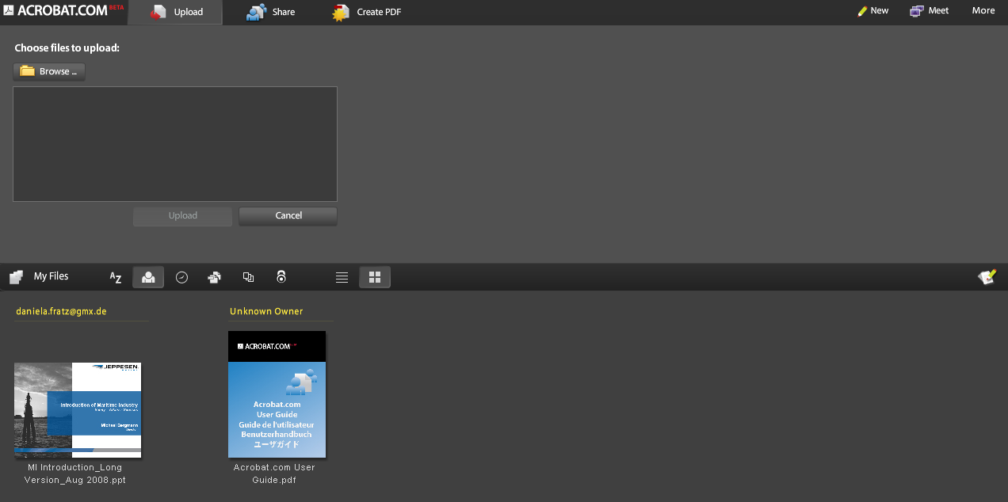
Adobe Share - Screenshots
Uploading and document storage page:

Slide 6
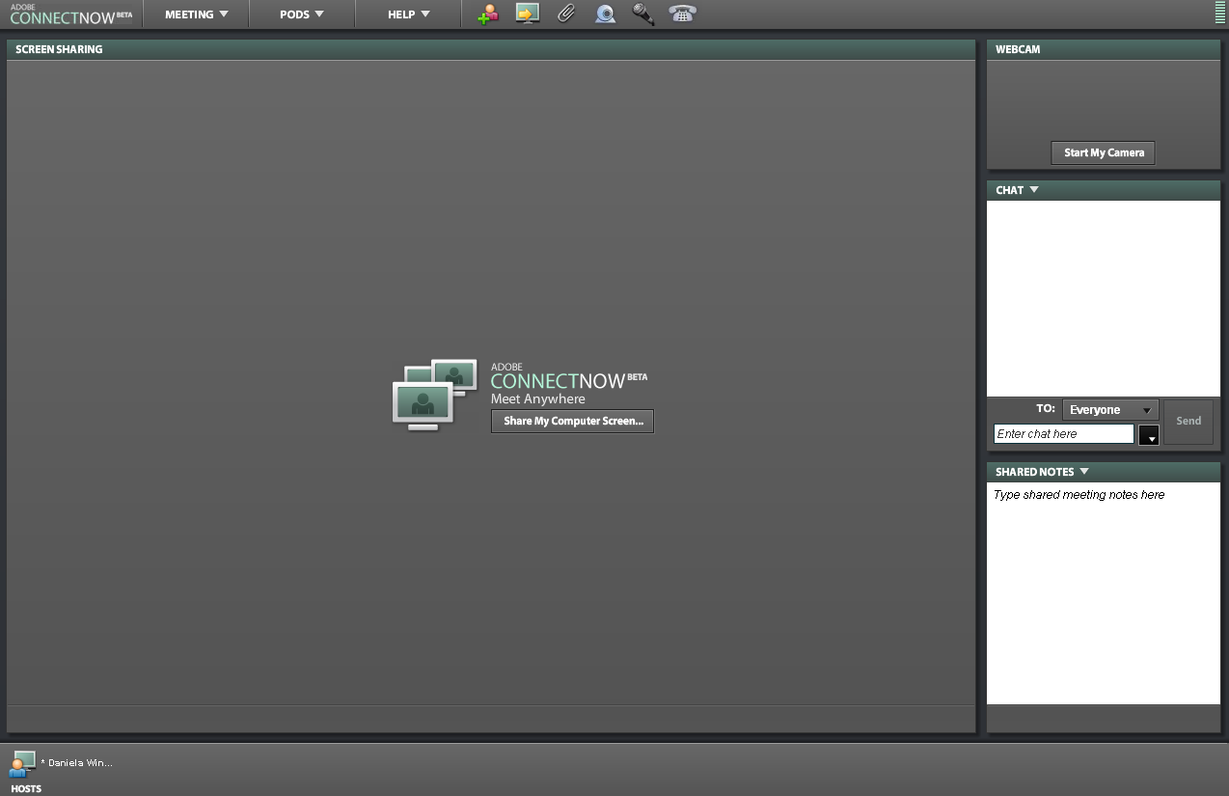
Adobe Share - Screenshots
Web conferencing page:

Slide 7
ThinkFree
Prerequisite: ThinkFree account (free of carge)
Desktop and online application available
Access control by read or write permissions per document
Web based document processor (create texts, presentations or spreadsheets online)
File management in folder structure possible
No forum or similar available
Some features a bit slow (eg. uploading, document processor)
Only 1 GB storage space
No web conferencing solution
=> Overall good tool, but limited space and slow

Slide 8
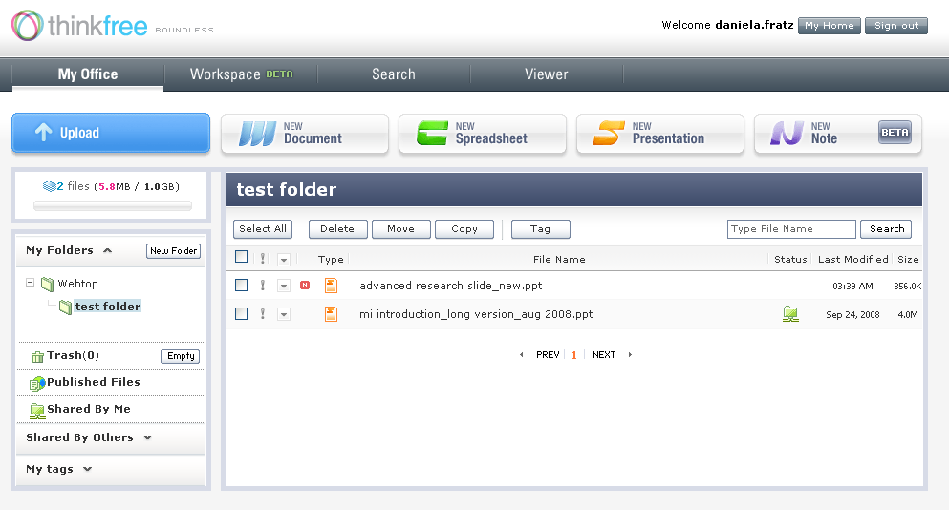
ThinkFree - Screenshots
Document storage page:

Slide 9
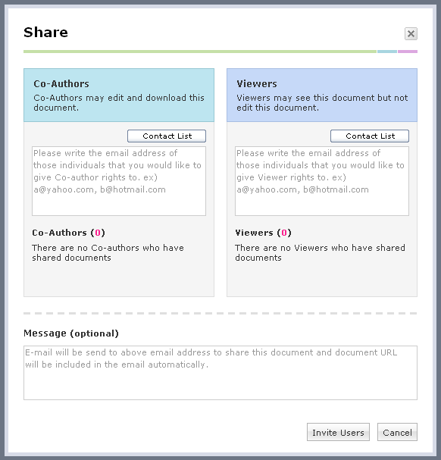
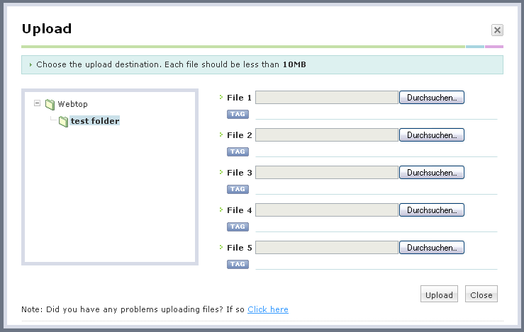
ThinkFree - Screenshots
Document sharing and uploading pages:

Slide 10
Google Docs
Prerequisite: Google account (free of carge)
Access control by read or write permissions per document
Web based document processor (create texts, presentations or spreadsheets online)
Web conferencing solution
File management in folder structure possible
Very intuitive and comprehensible layout
No forum or similar available
=> Very good tool, fulfills all objectives except forum

Slide 11
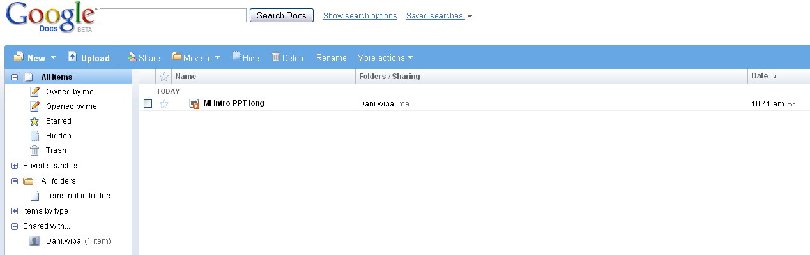
Google Docs - Screenshots
Document storage page:

Slide 12
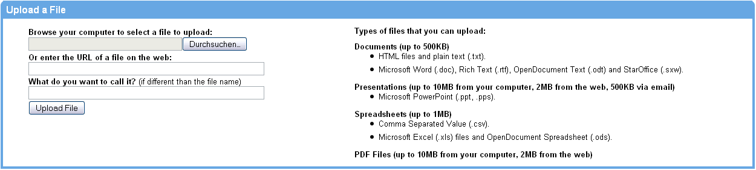
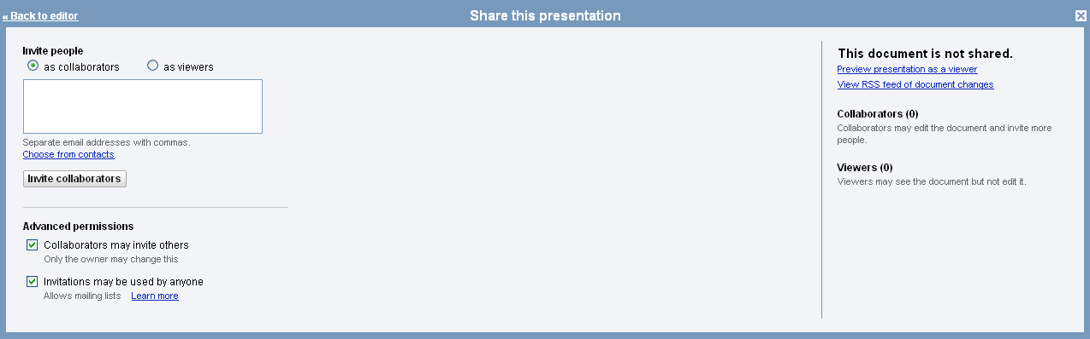
Google Docs - Screenshots
Document uploading and sharing pages:

Slide 13
Google Groups
Prerequisite: Google account (free of carge)
Access control by membership permissions
Forum feature for online discussions available
Group member list visible to all participants
Web page creation available within group space
Group email address available
No file management in folder structure possible
Only 100 MB storage space
Security: access to group space in general can be limited, but not per single documents separately
No web conferencing solution
No online viewing (documents need to be downloaded prior to viewing)
=> Different approach than previous tools. Very
good and useful tool; the only one with forum.

Slide 14
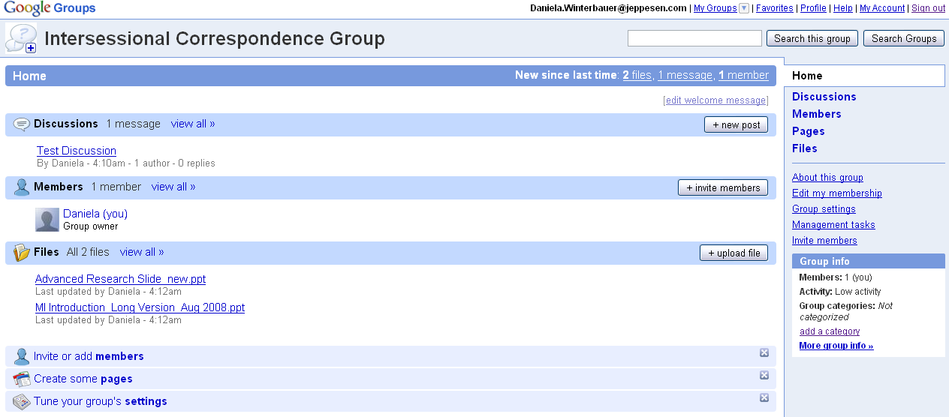
Google Groups - Screenshots
Group home page:

Slide 15
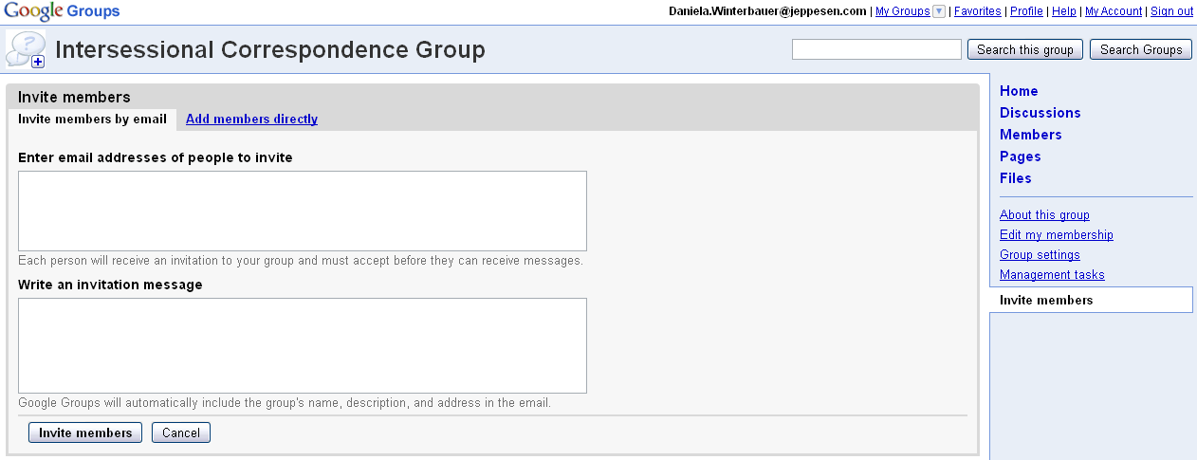
Google Groups - Screenshots
Invite members page:

Slide 16
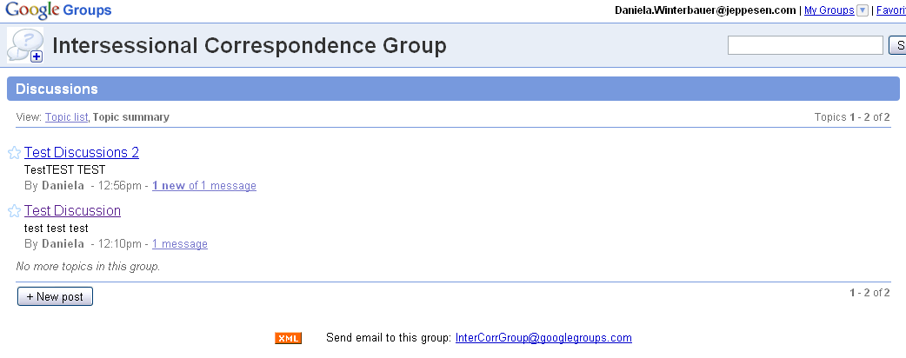
Google Groups - Screenshots
Discussion forum page:

Slide 17
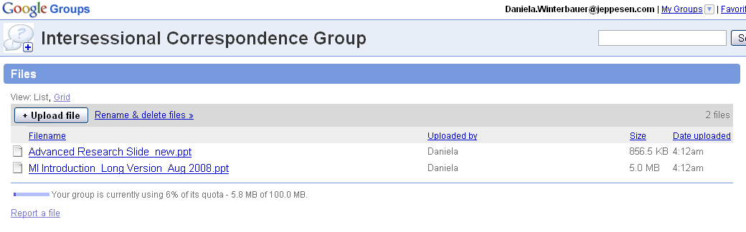
Google Groups - Screenshots
Document storage page:

Slide 18
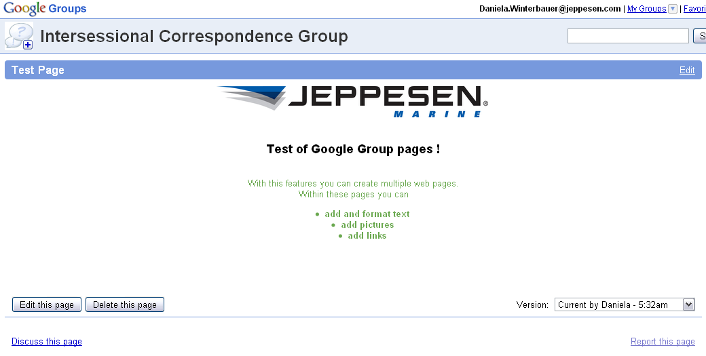
Google Groups - Screenshots
Web page creation example:

Slide 19
Suggestion
If Forum is more important than file management and web conferencing:
  Google Groups
If File Management and Web Conferencing is more important than a forum:
  Google Docs

Slide 20

Thank you
THANK YOU !

